Slide 1
BIG MOUNTAIN RESORT CASE STUDY
Strategy Plan 2025
Rinky Abraham

Slide 2
01
Problem Identification

Slide 3
Can we improve ticket price for Big Mountain ?
Big Mountain Ticket Price - $81
Market Price - ?

Slide 4
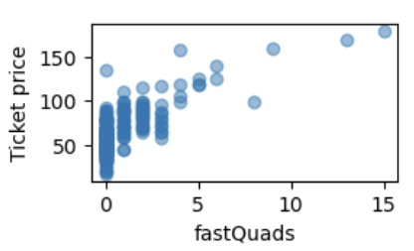
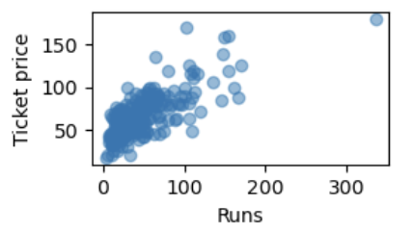
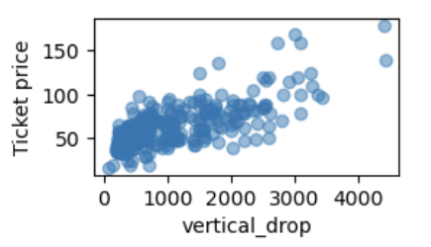
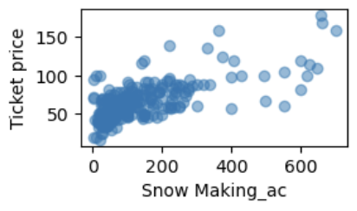
FEATURES INFLUENCING TICKET PRICE
FAST QUADS
RUNS
VERTICAL DROP
SNOW MAKING AREA ( acres)

Slide 5
02
Recommendation

Slide 6
SCENARIOS TO INCREASE REVENUE
SCENARIO 1
SCENARIO 2
SCENARIO 3
SCENARIO 4
Permanently closing down up to 10 of the least used runs. This doesn't impact any other resort statistics.
Increase the vertical drop by adding a run to a point 150 feet lower down but requiring the installation of an additional chair lift to bring skiers back up, without additional snow making coverage
Same as number 2, but adding 2 acres of snow making cover
Increase the longest run by 0.2 mile to boast 3.5 miles length, requiring an additional snow making coverage of 4 acres
ACTION PLAN
SCENARIO 2: IT BUMPS UP THE TICKET PRICE FROM $81 TO $95.87.
INCREASES REVENUE COLLECTION BY $3,474,638

Slide 7
03
MODEL RESULTS & ANALYSIS

Slide 8
AGENDA
01
DATA WRANGLING
02
EXPLORATORY DATA ANALYSIS (EDA)
03
PRE-PROCESSING
04
MODELLING

Slide 9
330 ski resort rows and 27 columns
Initial Data (csv file)
Clean Data
Drop Columns that were not informative in the analysis of ticket price
Drop Rows that had missing values
Check for Target Value
Verify if ticket predictor variable is present in data - AdultWeekend
Final Data - Set up for EDA
Store cleaned data (csv) - 270 rows , 25 columns
Generate a new dataset with state information to aid further analysis
Data Wrangling

Slide 10
No direct trends observed between AdultWeekend column and Feature columns
Check relationship of features
Perform PCA
No clear groupings in the prices by state.
Heatmaps for Correlation
Showed correlation of AdultWeekend with fastQuads, Runs, Vertical_Drop and total_chairs
Set up for Pre-processing
Store the analysis of important feature types for Pre-processing
Exploratory Data Analysis (EDA)

Slide 11
Scaling the data - StandardScaler
Imputing missing values using median
Clean data for ML model
Train Model on Random Forest Tree
(Mean , Std) = (9.644, 1.352)
Mean Absolute Error = 9.537
Train Model on Linear Regression
(Mean , Std) = (10.499, 1.622)
Mean Absolute Error = 11.793
Final Model Selected
Random Forest model is chosen for further analysis because it had lower Mean Absolute Error compared to Linear Regression Model
Pre-Processing

Slide 12
Plot distributions of important features and we see Big Mountain is among the big leagues of facilities provided at ski resorts
Verify Big Mountain facilities with the rest
Apply Random Forest Model
Predicted Price = $95.87
Actual Price = $81.00
Scenario Modelling
Model 4 scenarios discussed and check delta in revenue
Final Suggestion
By increasing the ticket price to $1.99, which considers increase in vertical_Drop by 150 feet and additional of a run and chair, we can generate a revenue of $3474638
Modelling

Slide 13
04
Closing Comments

Slide 14
Future Work ?
Model doesn’t account for operational cost, so something to consider in future after appropriate data collection
If adopted, strategies to maintain the model need to be considered.

Slide 15
Questions?

Slide 16
THANK YOU
COMPANY NAME

